Slide 1


HI6040 (Artificial Intelligence and Machine Learning)
Dr. Farshid Keivanian
Tutorial Week 6

Slide 2
Outline
What Students should do in week 6
Compare at least two classifiers
Evaluate with multiple metrics
Visualise results
Discuss trade-offs
Group Presentation

Slide 3
Compare at least two classifiers
Example: Logistic Regression vs Decision Tree (or SVM vs KNN).
Train both on the same dataset (Iris, Wine, or Breast Cancer from sklearn.datasets).

Slide 4
Evaluate with multiple metrics
Accuracy alone isn’t enough.
Students should report: accuracy, precision, recall, and F1-score.

Slide 5
Visualise Results
Confusion Matrix (confusion_matrix, ConfusionMatrixDisplay).
Maybe ROC curve (roc_curve and auc) for extra engagement.

Slide 6
Discuss trade-offs
Example: “This model is good at identifying healthy patients but misses more positive cases” → introduces the concept of false negatives vs false positives.

Slide 7
Group Presentation
Each group presents their findings in 2–3 slides:
Dataset summary (shape, features, labels).
Model comparison table.
Key insights from confusion matrix/metrics.

Slide 8
Model Comparison: Logistic Regression vs Decision Tree
Train both classifiers on the Breast Cancer dataset (or another dataset from sklearn.datasets).
Evaluate accuracy, precision, recall, and F1-score.
Visualise the results using a confusion matrix.

Slide 9
Model Comparison: Logistic Regression vs Decision Tree
Critical lines of code:
lr = LogisticRegression(max_iter=500).fit(X_train, y_train)
dt = DecisionTreeClassifier(max_depth=4).fit(X_train, y_train)
print(classification_report(y_test, lr.predict(X_test)))
print(classification_report(y_test, dt.predict(X_test)))
Discussion Prompt:
Which model performs better? Why might one be better at detecting positives?

Slide 10
Sample Presentation Talking Points
(so you don’t just read code outputs)
Dataset: Breast Cancer dataset → 30 features, binary classification.
Models Compared: Logistic Regression (linear model) vs Decision Tree (non-linear).
Findings:
Logistic Regression had higher recall (better at catching positives).
Decision Tree had slightly higher accuracy but missed more positives.
Confusion Matrix shows more false negatives in Decision Tree.
Discussion Question: In healthcare, which metric matters more – accuracy or recall?

Slide 11
Keywords
Accuracy: “How many predictions were correct overall.”
Precision: “When the model says YES, how often is it right?”
Recall: “Out of all the actual YES cases, how many did the model find?”
Confusion Matrix: “A table that shows where the model got things right and wrong.”

Slide 12
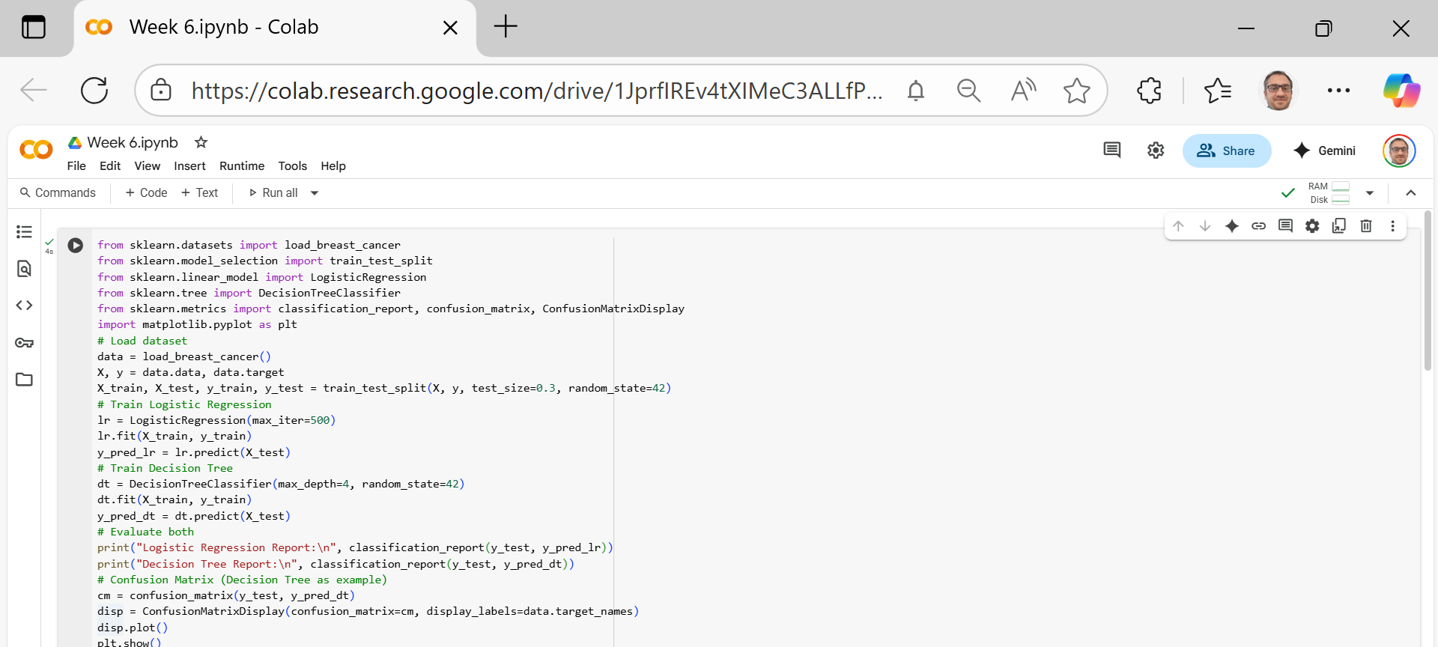
Example Code
Importing the tools we need
These are the libraries we use:
load_breast_cancer: gives us a ready-made dataset (patients with/without cancer).
train_test_split: splits data into training and test sets.
LogisticRegression and DecisionTreeClassifier: the two models we want to compare.
classification_report, confusion_matrix, ConfusionMatrixDisplay: tools to check how good our models are.
matplotlib.pyplot: for plotting (showing graphs)

Slide 13
Example Code
2. Load the dataset
data = breast cancer dataset from sklearn.
X = the features (measurements about the tumor, like size, texture, etc.).
y = the label (0 = cancer, 1 = no cancer).

Slide 14
Example Code
3. Split into training and test data
We divide data into:
70% training set (to train the models).
30% test set (to check how good the models are).
random_state=42 → ensures we always get the same split (so results are reproducible).

Slide 15
Example Code
4. Train Logistic Regression
Create a Logistic Regression model (lr).
Train (fit) on training data.
Predict (predict) the outcomes for test data.
max_iter=500: allows the model more steps to find the best solution.

Slide 16
Example Code
5. Train Decision Tree
Create a Decision Tree model (dt).
Limit tree depth to 4 (max_depth=4) so it doesn’t overfit.
Train and predict like before.

Slide 17
Example Code
6. Evaluate both models
Show precision, recall, F1-score, and accuracy for both models.
This tells us how well each model predicted cancer vs no cancer.

Slide 18
Example Code
7. Visualise the Confusion Matrix
Make a confusion matrix for Decision Tree.
It shows:
How many patients were correctly classified.
How many were misclassified (false positives/false negatives).
plt.show() → displays the chart.

Slide 19
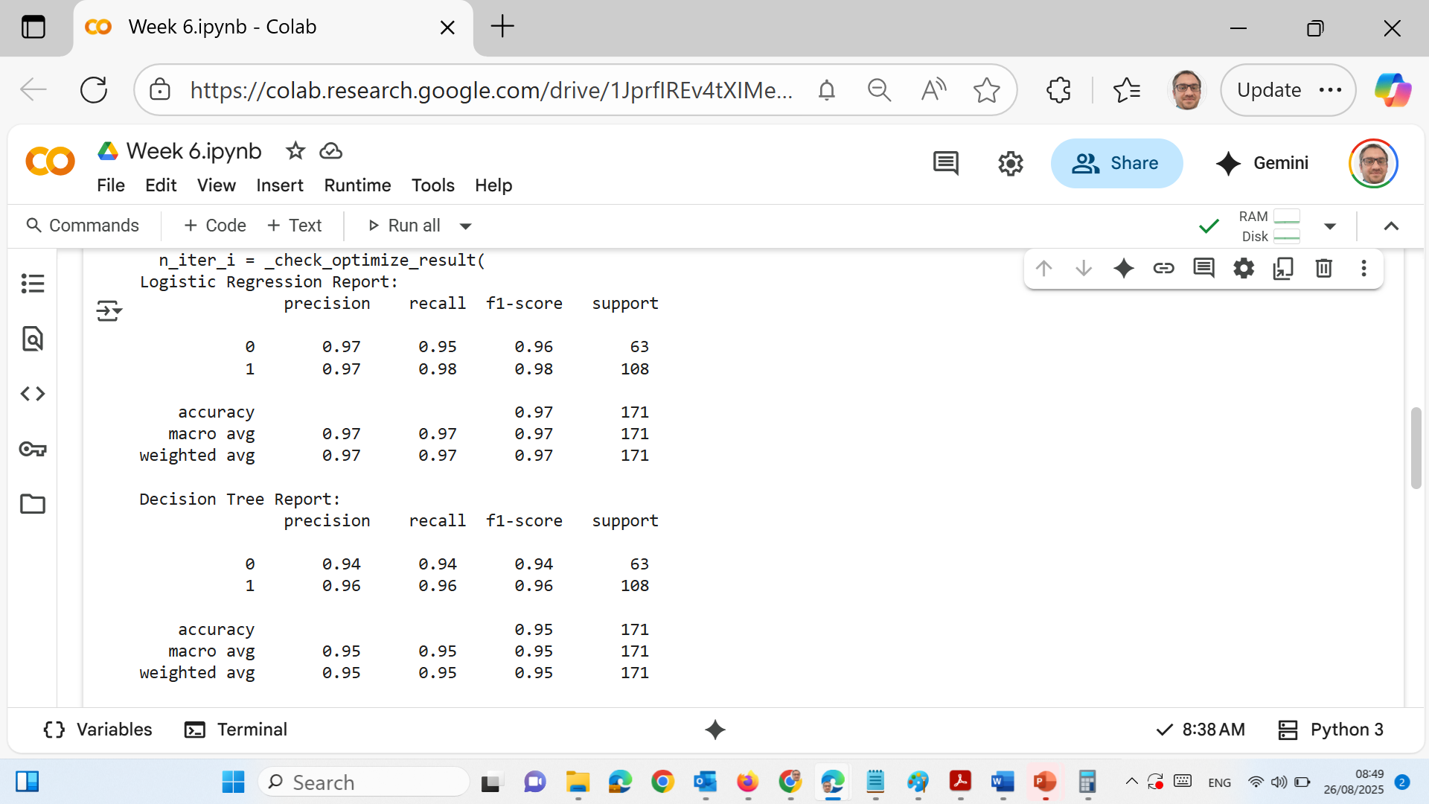
Results
Here we compared Logistic Regression and Decision Tree models on the Breast Cancer dataset.
Logistic Regression Results
Accuracy = 97%
Class 0 (malignant): Precision 0.97, Recall 0.95, F1 = 0.96
Class 1 (benign): Precision 0.97, Recall 0.98, F1 = 0.98
This means the model is very good at identifying both malignant and benign cases, with only a few mistakes.

Slide 20
Results
Decision Tree Results
Accuracy = 95%
Class 0 (malignant): Precision 0.94, Recall 0.94, F1 = 0.94
Class 1 (benign): Precision 0.96, Recall 0.96, F1 = 0.96
Slightly lower than Logistic Regression, but still strong overall.
takeaway: Logistic Regression performed a little better overall (97% vs. 95%), especially in detecting malignant cases. Decision Trees are easier to interpret, but Logistic Regression gave higher accuracy.

Slide 21
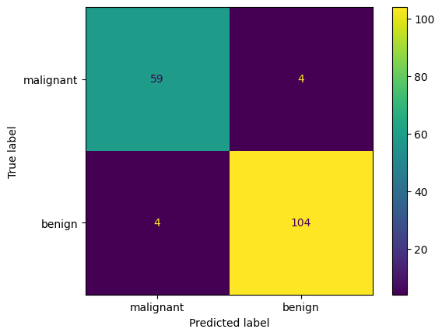
Results
how well the Decision Tree classified patients:
Top-left (59) → Correctly predicted malignant.
Top-right (4) → Mistakenly predicted benign instead of malignant (false negatives).
Bottom-left (4) → Mistakenly predicted malignant instead of benign (false positives).
Bottom-right (104) → Correctly predicted benign.

Slide 22
Results
takeaway: Most predictions are correct. But the model missed 4 malignant cases by classifying them as benign. This is serious in healthcare because missing a cancer diagnosis is riskier than a false alarm.

Slide 23
Results
Student Discussion Points
Why might Logistic Regression perform better than Decision Tree on this dataset?
Which metric is more important in healthcare — accuracy, precision, or recall? Why?
If you had to choose one model for hospital deployment, which would you pick and why?

Slide 24
Thank You
Need Help with coding? Send an email or ask during the tutorial session.
FKeivanian@my.holmes.edu.au

